Slide 1
Lab 04 Laying Out Controls in Containers
By
M.Zakir Khan

Slide 2
A container is a view used to contain other views. Android offers a collection of view classes that act as containers for views. These container classes are called layouts, and as the name suggests, they decide the organization, size, and position of their children views.

Slide 3
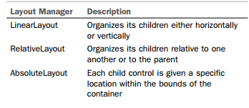
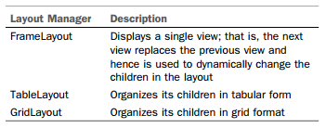
Introduction to Layouts
Layouts are basically containers for other items known as Views, which are displayed on the screen.
Layouts help manage and arrange views as well.
Layouts are defined in the form of XML files that cannot be changed by our code during runtime.

Slide 4
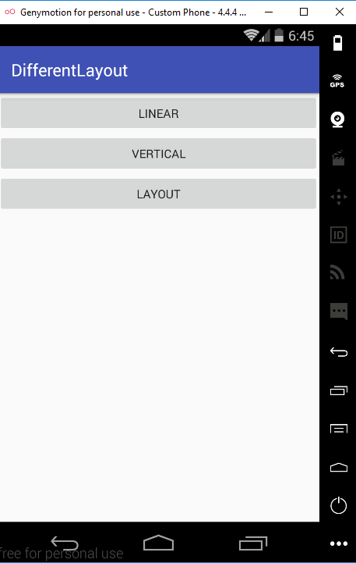
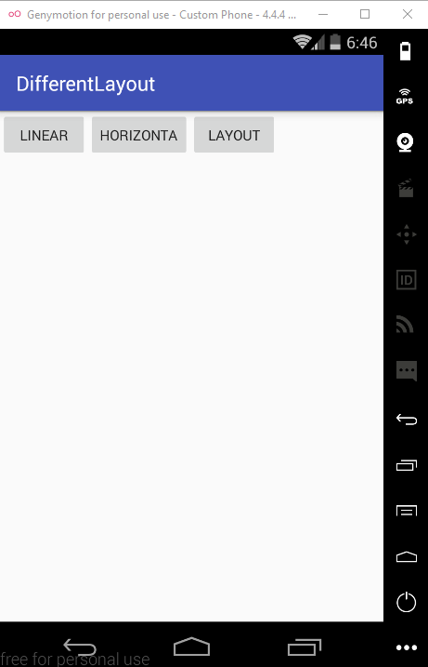
Linear Vertical and Horizontal Layout

Slide 5
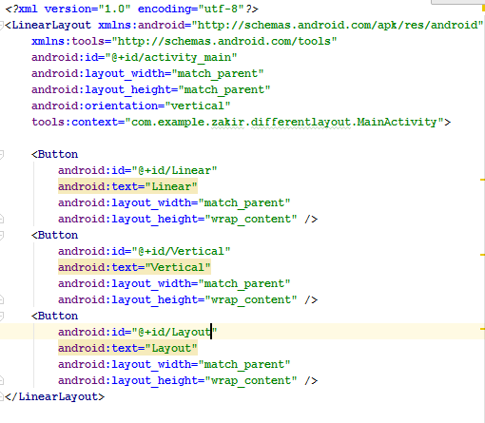
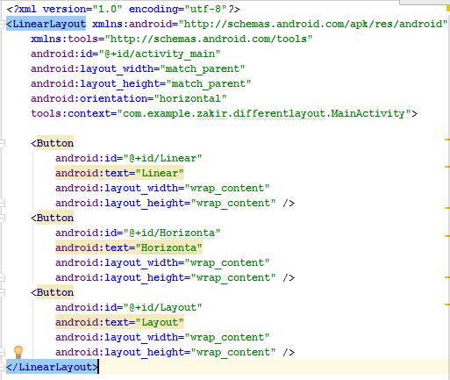
XML Code

Slide 6

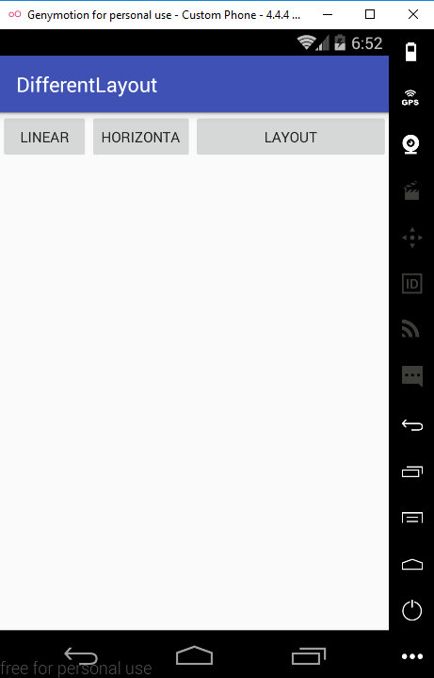

Applying the weight Attribute
Apply different weight attribute like (0.0,1.0,0.0), (0.0,0.0,1.0) and (1.0,1.0,1.0)

Slide 7
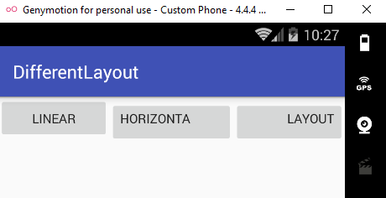
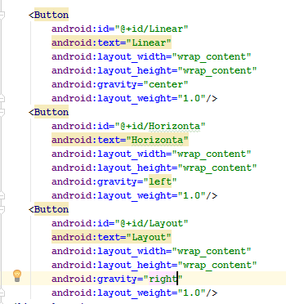
Applying the Gravity Attribute
The Gravity attribute is for aligning the content within a control.
For example, to align the text of a control to the center
Figure shows the android:gravity attribute set to left and right for the Button controls Horizontal and Layout text over button.

Slide 8
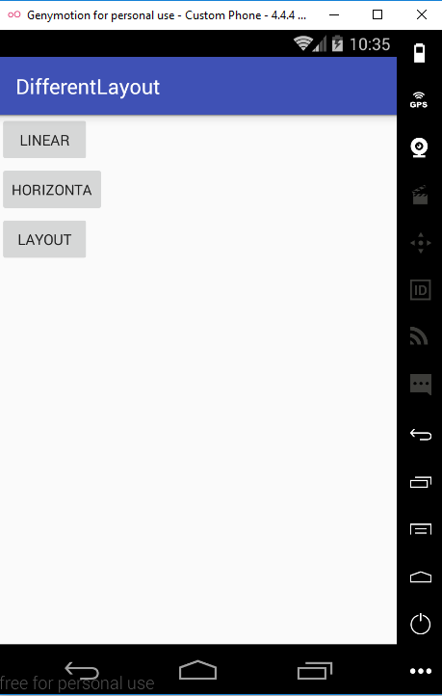


Using the android:layout_gravity Attribute
Where android:gravity is a setting used by the View
The android:layout_gravity is used by the container.
This attribute is used to align the control within the container.
For example,to align the Button control itself in the LinearLayout (the container), we use the android:layout_gravity attribute

Slide 9
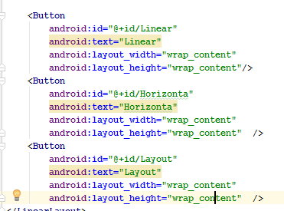
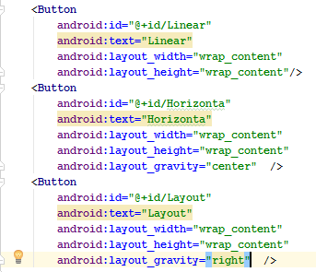
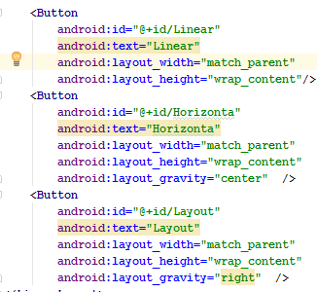
XML Code

Slide 10
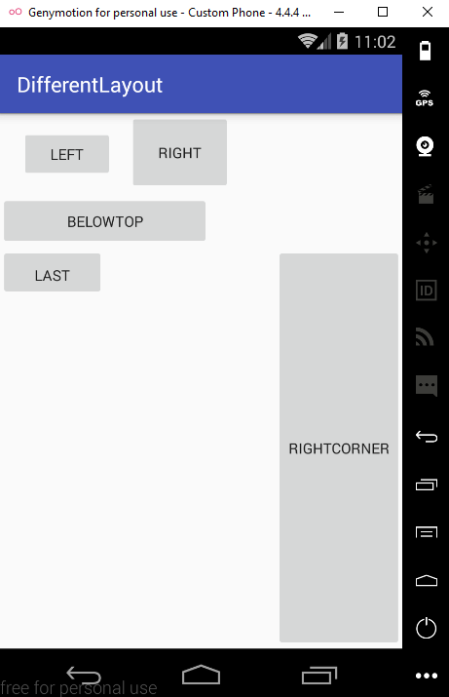
RelativeLayout
In RelativeLayout, each child element is laid out in relation to other child elements;

Slide 11
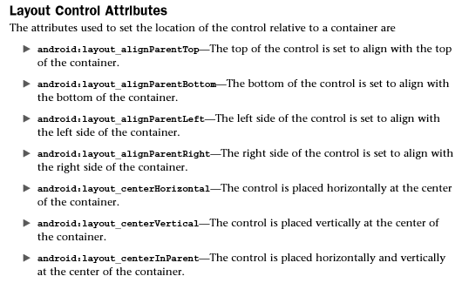
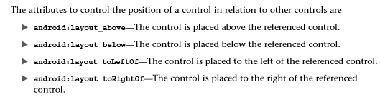
Before we understand how the controls in the previous code block are placed, let’s have a quick look at different attributes used to set the positions of the layout controls.

Slide 12
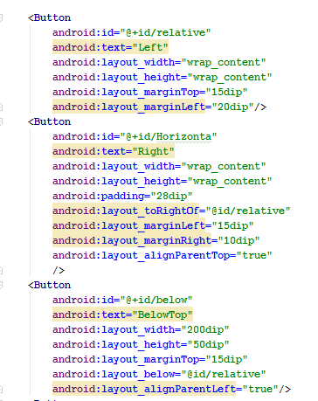
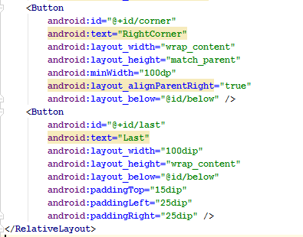
XML CODE

Slide 13
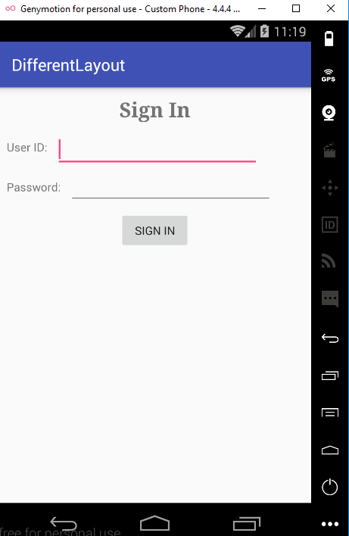
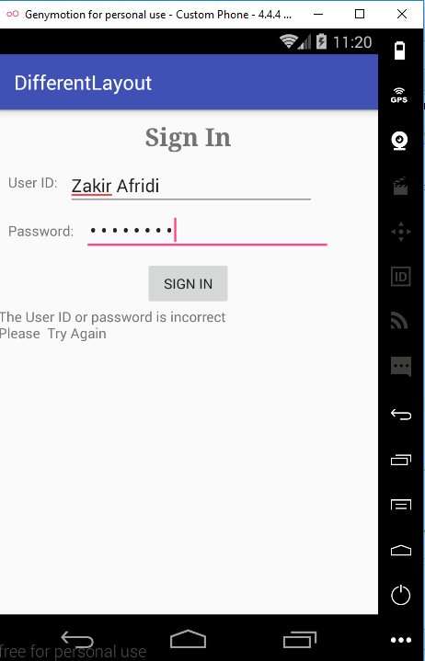

Example on Relative Layout

Slide 14
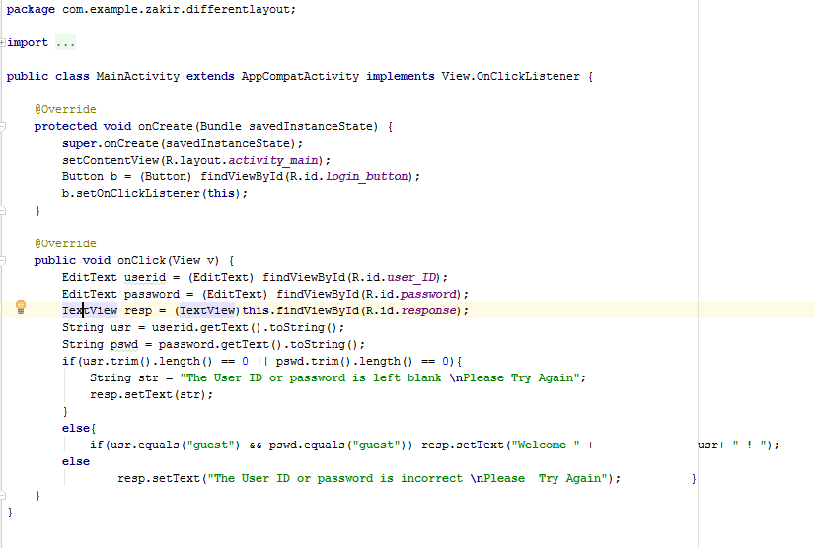
JAVA code

Slide 15
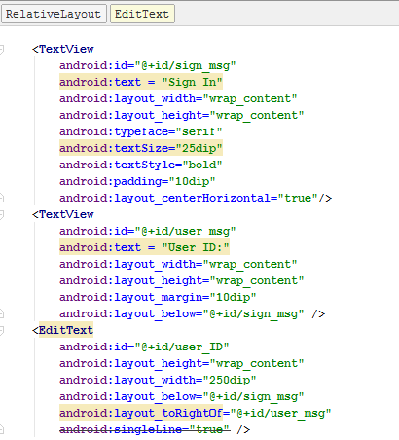
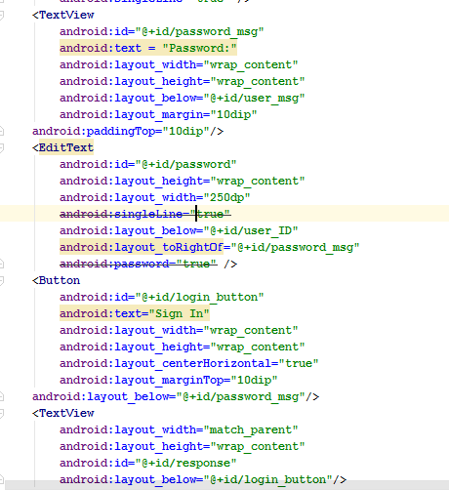
XML Code

Slide 16
Absolute Layout
Each child in an AbsoluteLayout is given a specific location within the bounds of the container.
Such fixed locations make AbsoluteLayout incompatible with devices of different screen size and resolution
The controls in AbsoluteLayout are laid out by specifying their exact X and Y positions.
The coordinate 0,0 is the origin and is located at the top-left corner of the screen.

Slide 17
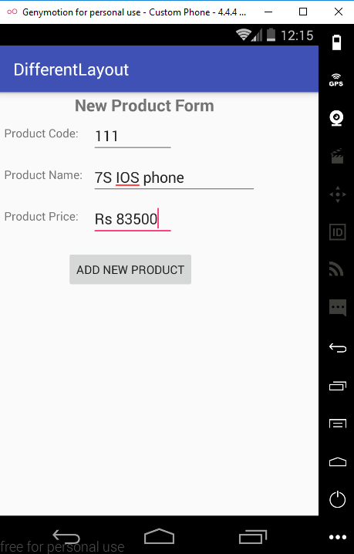
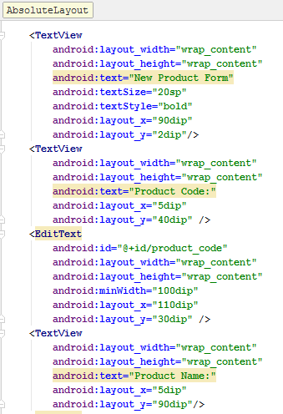
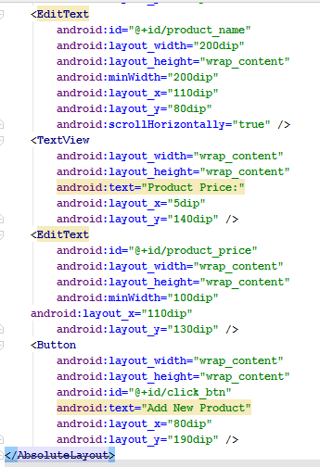
Java Code

Slide 18
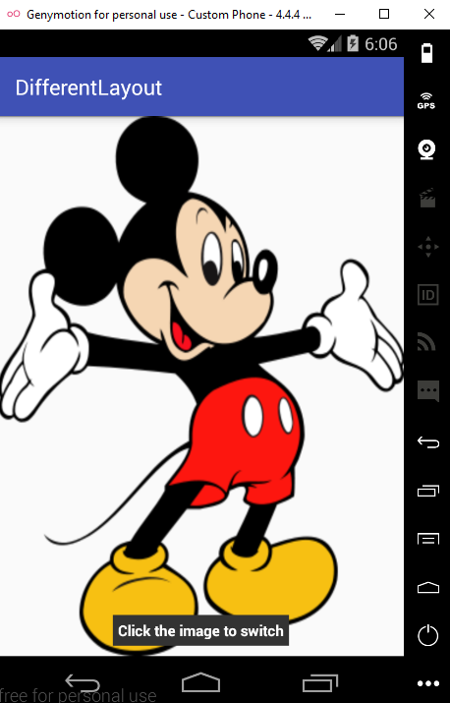
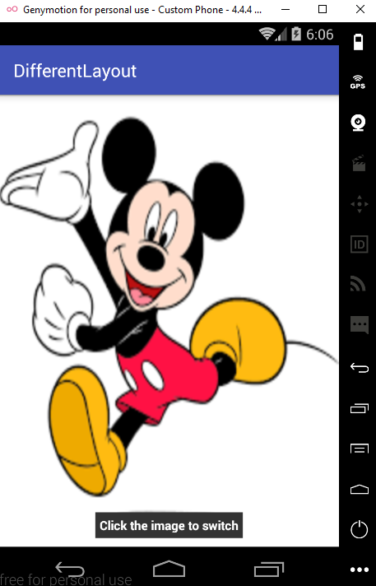
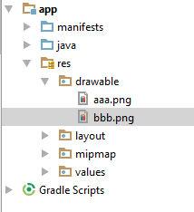
Frame Layout
FrameLayout is used to display a single View .
The View added to a FrameLayout is placed at the top-left edge of the layout.
Any other View added to the FrameLayout overlaps the previous View; that is, each View stacks on top of the previous one.

Slide 19
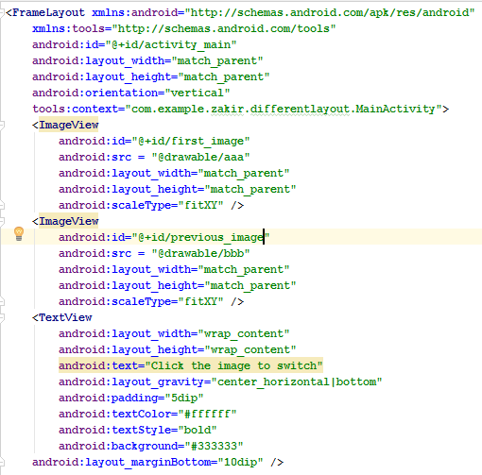
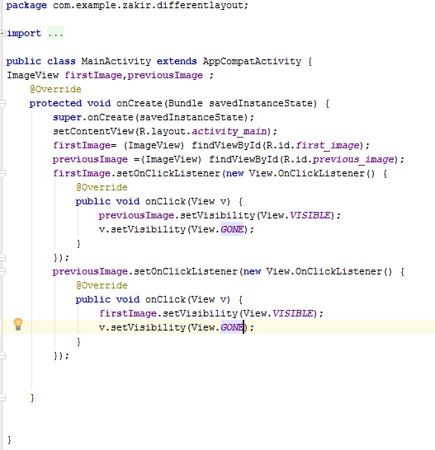
XML and JAVA Code

Slide 20
Table Layout
The TableLayout is used for arranging the enclosed controls into rows and columns.
Each new row in the TableLayout is defined through a TableRow object
A row can have zero or more controls, where each control is called a cell .
The number of columns in a TableLayout is determined by the maximum number of cells in any row.
The width of a column is equal to the widest cell in that column.

Slide 21
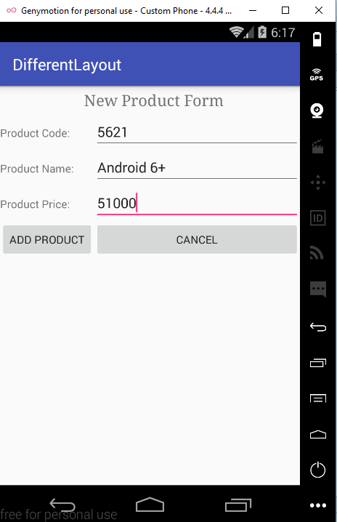
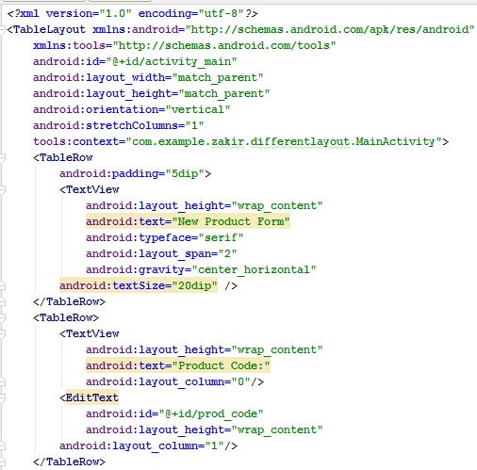
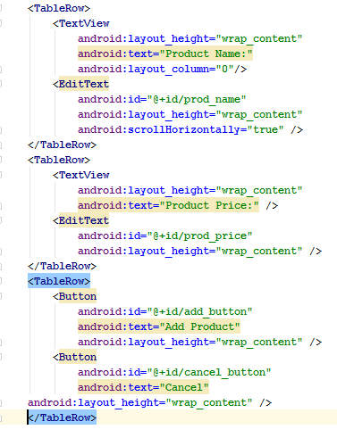
XML Code

Slide 22
GridLayout Layout
GridLayout lays out views in a two-dimensional grid pattern, that is, in a series of rows and columns.
The intersection of row and column is known as a grid cell, and it is the place where child views are placed.
It is easier to use GridLayout when compared to TableLayout.
Note
No need to specify layout_height and layout_width for the GridLayout child views as they default to WRAP_CONTENT .

Slide 23

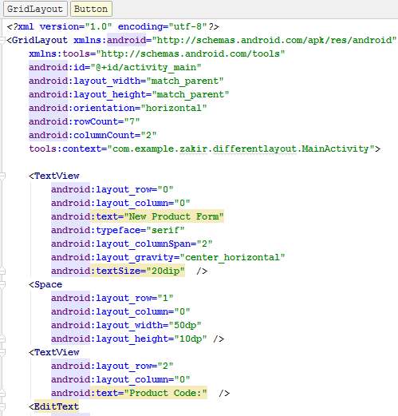
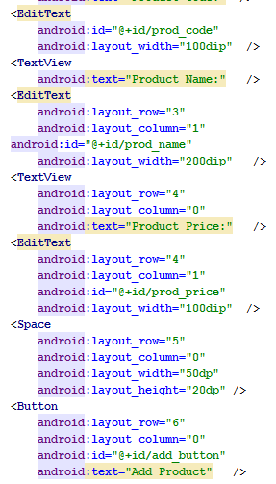


Slide 24
Anchoring Controls
For anchoring controls relative to the four edges of the screen, we use a RelativeLayout container.
Defining Layout for Each Mode
In this method, we define two layouts. One arranges the controls in the default portrait mode, and the other arranges the controls in landscape mode.
If we see the code of Relative layout shows five Button controls arranged in a RelativeLayout container

Slide 25
When the application is run while in the default portrait mode, the controls appear as shown in Figure (Left). The xml code of the figure left is already present in relative layout slide.
To switch between portrait mode and landscape mode on the device emulator, press the Ctrl+F11 keys

Slide 26
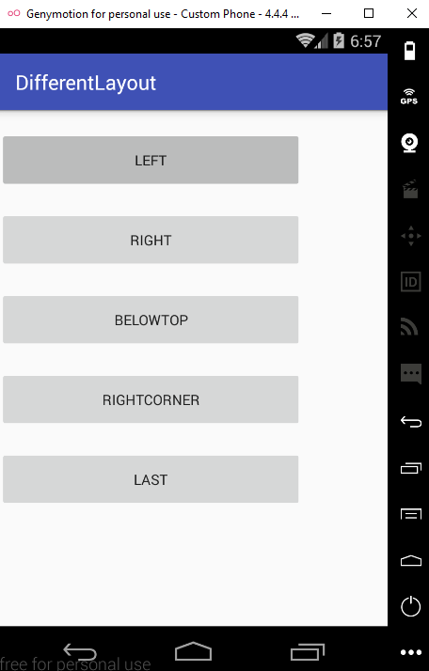
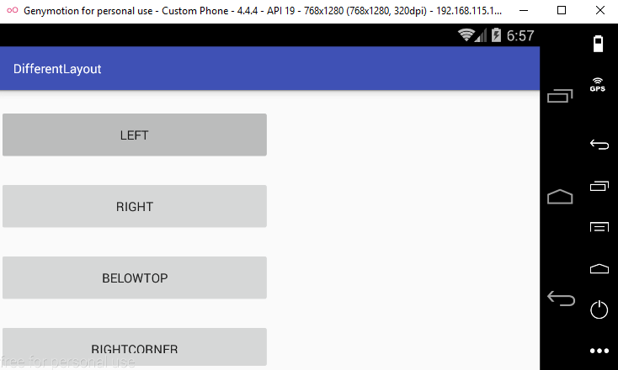
Defining Layout for Each Mode
In this method, we define two layouts. One arranges the controls in the default portrait mode, and the other arranges the controls in landscape mode.

Slide 27
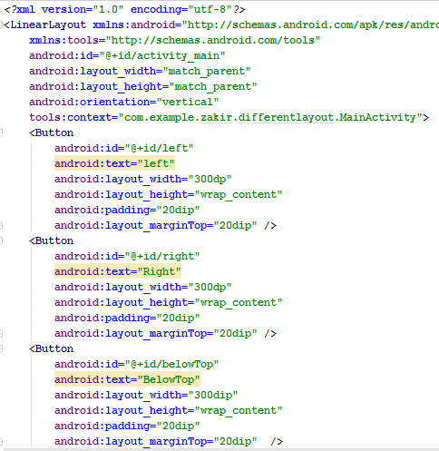
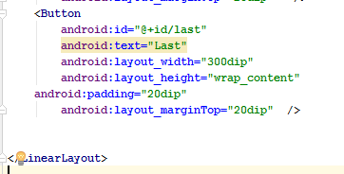
The code of previous slide is shown below.

Slide 28

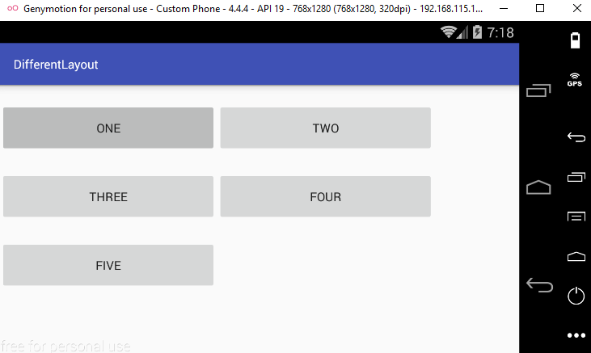
The Landscape and patriot mode is shown

Slide 29
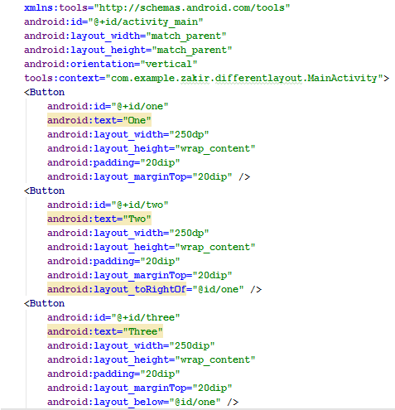
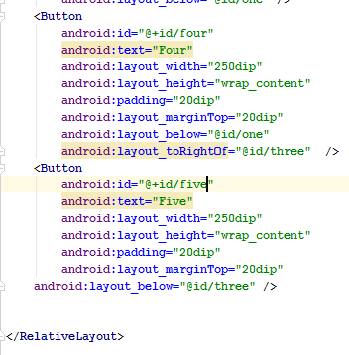

Slide 30
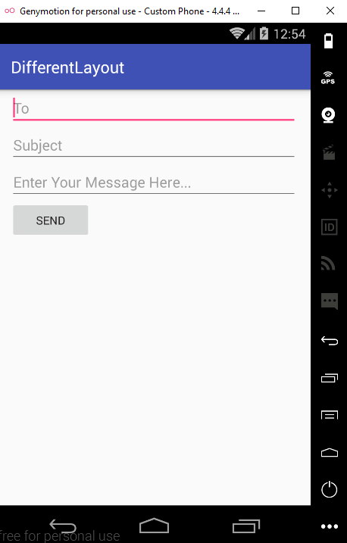
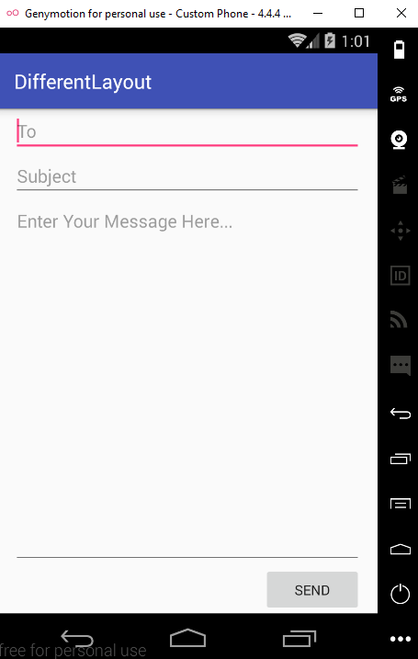
Task on Linear Layout

Slide 31
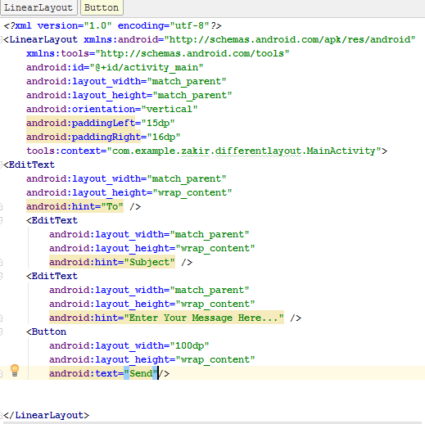
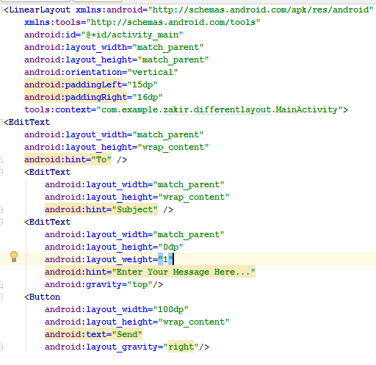
XML code

Slide 32
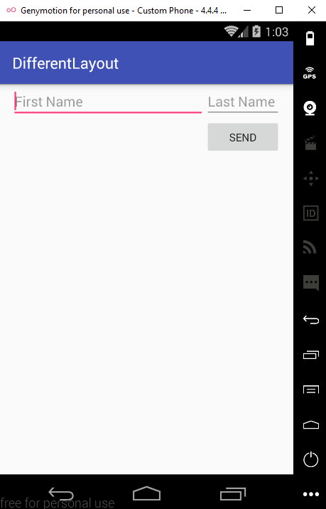
Task on Relative Layout

Slide 33
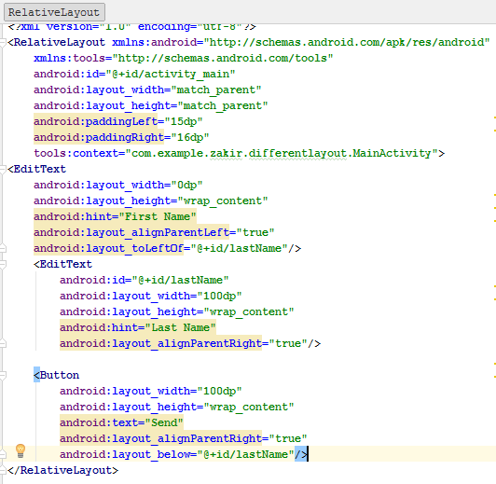
XML Code

